Slide 1
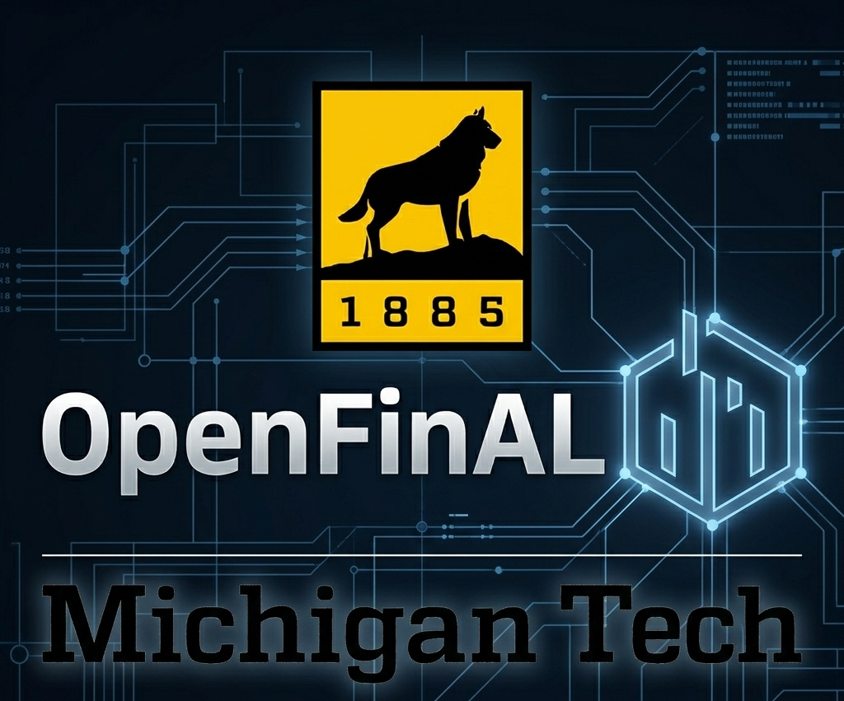
A Student-built, Financial AI and Analytics Educational Tool

Slide 2
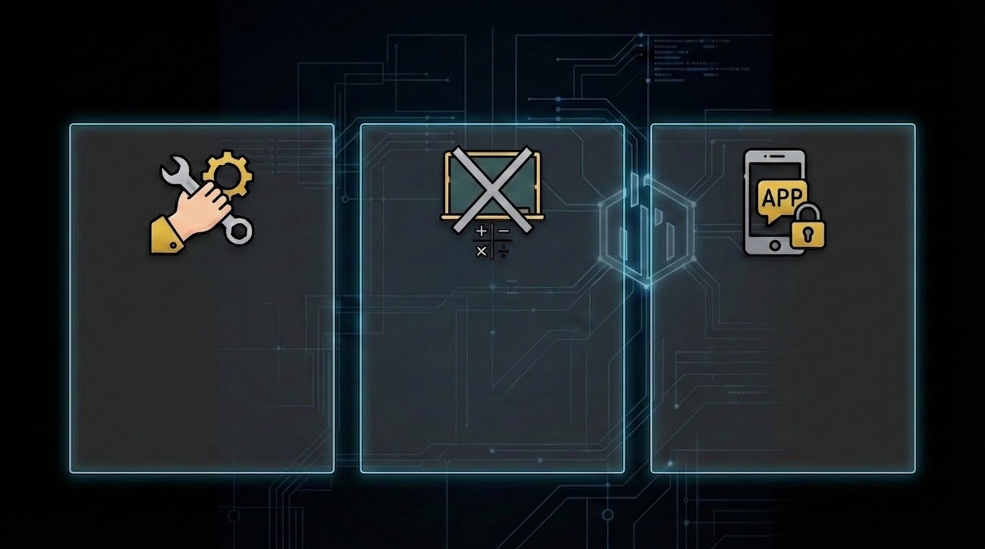
The Need
Students lack hands-on experience with real financial tools
Classroom learning doesn’t fully replicate real-world decision-making
Limited access to application development

Slide 3
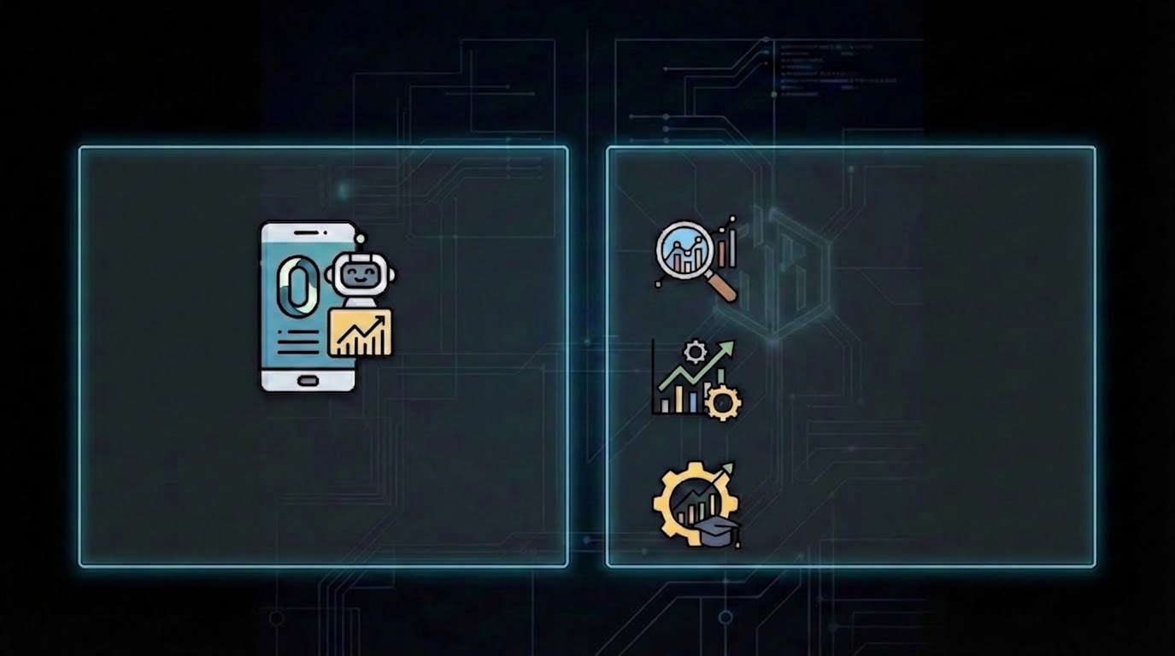
The Product
Stock market research
Track & analyze portfolio performance
A financial AI and analytics educational application designed by students
Build practical skills

Slide 4

Impact & Progress
What our section has already done:
Improved usability and functionality of the platform
Designed with input from students/alumni
Built for continued use by future classes
Bridges the gap between academic concepts and real-world financial practice

Slide 5

Ways to Engage
We’re looking for professionals and alumni to help support and refine this platform!
Provide feedback on real-world relevance
Mentor students developing the tool
Support continued development

